Slide 1
Detection of Phishing Sites using ML
Group Members
Gauri S Pisharady
Shriya Sanjay Narikutty Koilery

Slide 2
Abstract
An increase of 61% was observed in phishing attacks over the span of a year which necessitates security measures to be taken against them
Detection of phishing sites can mitigate these attacks
Machine Learning Techniques have emerged as effective tools to identify phishing websites
The objective is to train machine learning models using a dataset of both phishing and benign URLs to predict phishing websites by identifying various features such as Domain, IP address & HTML and JS features
The performance levels of these models will be measured & compared

Slide 3
Introduction
Over 90% of cyber attacks begin with phishing attacks
Phishing is a type of cybercrime in which hackers send fake URLs to targets to gain sensitive information or lead to installation of malicious software
Phishing websites are a common social engineering method of cybercrime
The main reason behind phishing attacks being so prevalent is the lack of awareness among users. Prevention of such attacks can start with making people conscious in addition to building strong security mechanisms which are able to detect and prevent phishing techniques from reaching the user.

Slide 4
Introduction
Dataset
The set of phishing URLs are collected from an opensource service called PhishTank. This service provides a set of phishing URLs in multiple formats like csv, json etc. that gets updated hourly.
The legitimate URLs are obtained from the open datasets of the University of New Brunswick.
These URLs are used to train the ML model

Slide 5
Literature Review
Title | Proposed | Inference
“An Efficient Approach for Phishing Detection using Machine Learning” Gandotra, Ekta & Gupta, Deepak (2021) 10.1007/978-981-15-8711-5_12 | Employs feature extraction mechanisms to capture diverse phishing website characteristics, such as URL-based, visual, and content-based features | Utilizing various ML algorithms it achieved accurate identification with high detection rates and low false positive rates
“Applications of deep learning for phishing detection” Catal, C., Giray, G., Tekinerdogan, B. et al. Knowl Inf Syst 64, 1457–1500 (2022) 10.1007/s10115-022-01672-x | Proposed a deep-learning based approach Designed a convolutional neural network architecture that leverages visual and textual features extracted from web pages | Exhibits better performance over traditional methods High accuracy in identification of phishing websites even with complex attack strategies and obfuscation techniques

Slide 6
Literature Review
Title | Proposed | Inference
"PhishGuard: Machine Learning-Based Real-Time Phishing Detection" | Employs an ensemble of classifiers for classifying web pages as legitimate or phishing incorporates a dynamic feature extraction module that captures structural and behavioral characteristics of web pages | Prompt and accurate detection of phishing websites Enhances user protection
"Towards web phishing detection limitations and mitigation“ Abuadbba, Alsharif, et al. arXiv:2204.00985 (2022) | discusses drawbacks in current phishing detection techniques & methods to improve them Proposed an Anti-SubtlePhish System Design utilizing Information Retrieval, correlation & feature extraction and phishing detection | Achieved high accuracy, precision and recall with quick detection flagged out all zero day phishing sites in the testing dataset on the first day

Slide 7
Literature Review
Title | Proposed | Inference
"Novel approach to phishing detection using ML and visual similarity” Sanghavi, Preet, et al. Machine Learning and Autonomous Systems: Proceedings of ICMLAS 2021. Singapore: Springer Nature Singapore, 2022. 117-131. | Proposes 2 approaches, first by tackling phishing using ML models of classifiers and second by using visual similarity with FFT with MSE & SSIM values | Classfier works better when most significant features are present in training set An ML model can be trained to accurately understand how the threshold value for SSIM varies
“Phishing Website Detection using Machine Learning Algorithms” International Journal of Computer Applications (0975 – 8887) Volume 181 – No. 23, October 2018 | Three machine learning classification models -Decision Tree, Random forest and Support vector machine has been selected to detect phishing websites and comparison is done between them with different data split ratio to compares the accuracy score | Overall, among the machine learning classification models, Random forest out performed with consistent best accuracy scores. The data split ratio that proved to be the most efficient among them was 90:10

Slide 8
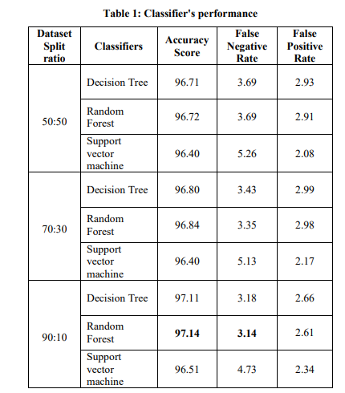
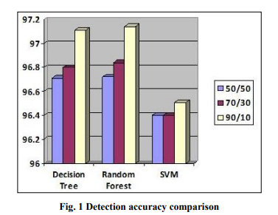

Slide 9
Literature Review
Learning
showcased the capabilities of machine learning & deep learning techniques in accurately identifying phishing websites
Establish the data set most suitable for each model suggested
Compared the different classical machine and deep learning models that can be used with its accuracy percentage in order to decide which is the most feasible one
providing valuable insights for combating the ever-evolving threats posed by phishing attacks in real-time scenarios
Dataset used:
For phishing: https://www.phishtank.com/developer_info.php
For benign URL: https://www.unb.ca/cic/datasets/url-2016.html

Slide 10
Thank You

